Slide 1
Intro to GraphRAG
John Alexander Apurva Mody
Sr. Content Developer, Azure AI Apps Principal Program Manager, Office of CTO RD
Microsoft Microsoft

Slide 2
Agenda
Graph Fundamentals
Querying the Graph
RAG With Neo4j and LangChain
MSFT GraphRAG

Slide 3
Graph Fundamentals

Slide 4
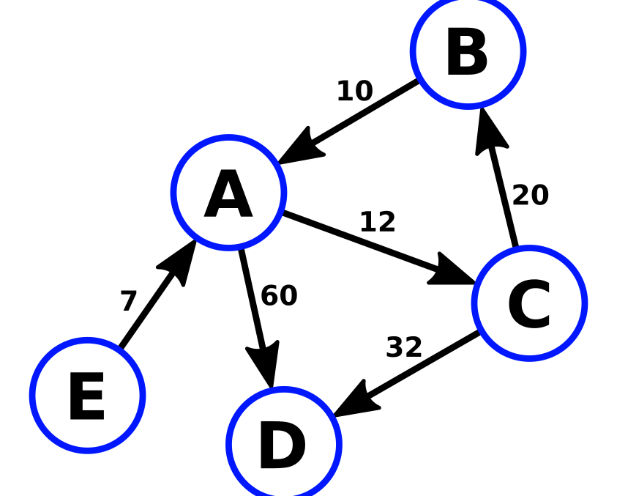
Graph Theory
Graph is a set of Nodes (Vertices) and Relationships (Edges)
This Photo by Unknown Author is licensed under CC BY-SA

Slide 5
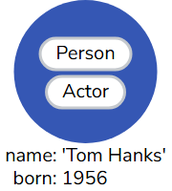
Nodes
Labels
Describe entities (discrete objects) of a domain.
Have zero or more labels to define (classify) what kind of nodes they are.
Can have properties (key-value pairs), which further describe them.
Properties
Image source: neo4j.com/docs/getting-started/_images/graph_single_node-arr.svg

Slide 6
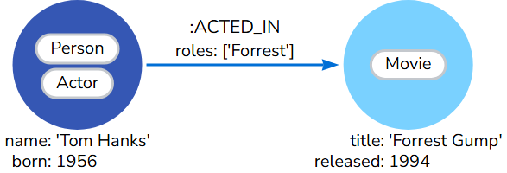
Relationships
Connect a source node and a target node.
Has a direction (one direction).
Must have one type (ingoing, outgoing) to define the relationship type.
Can have properties (key-value pairs)
type
property
Image source: neo4j.com/docs/getting-started/_images/graph_simple-arr.svg

Slide 7
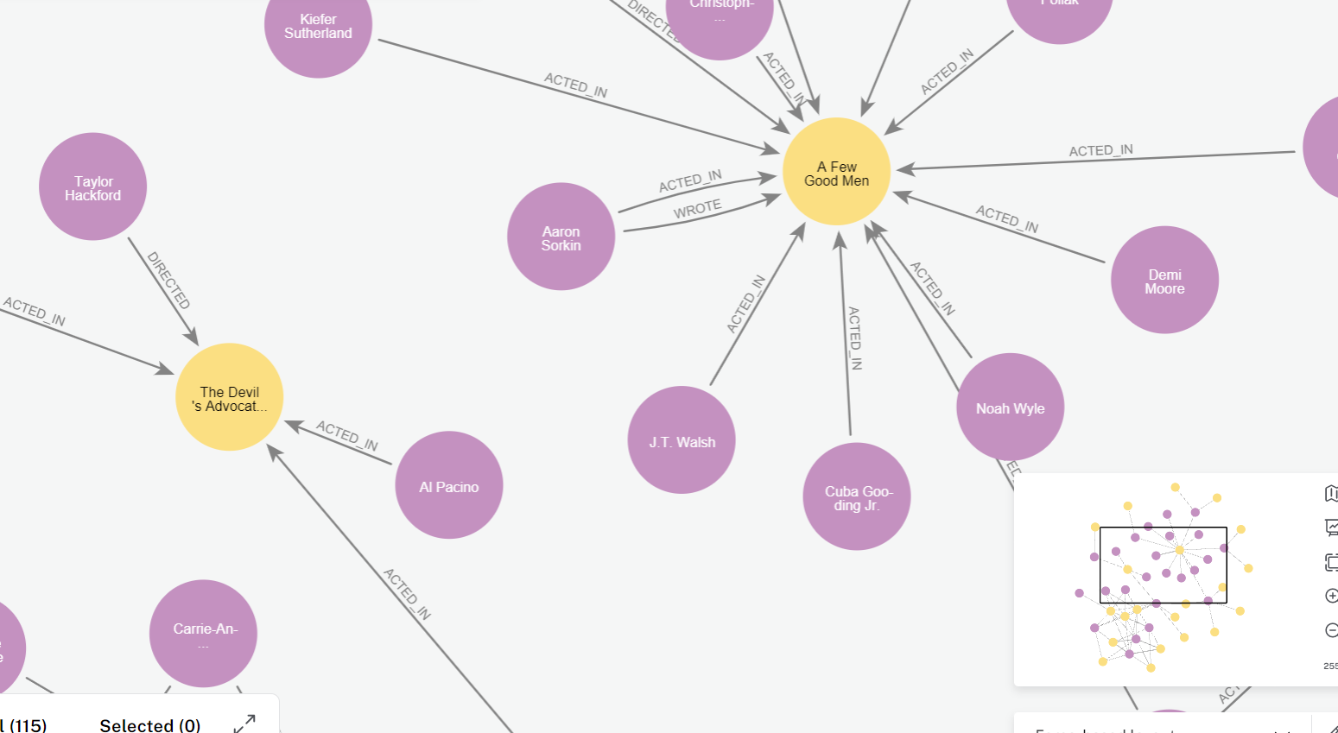
Graph Database
uses graph structures with nodes, edges, and properties to represent and store data.
designed for more efficient data handling with complex relationships and connections than traditional relational databases.

Slide 8
Knowledge Graph is a knowledge base
that uses a graph-structured data model or topology to represent and operate on data
Or
of interconnected entities defined by a schema

Slide 9
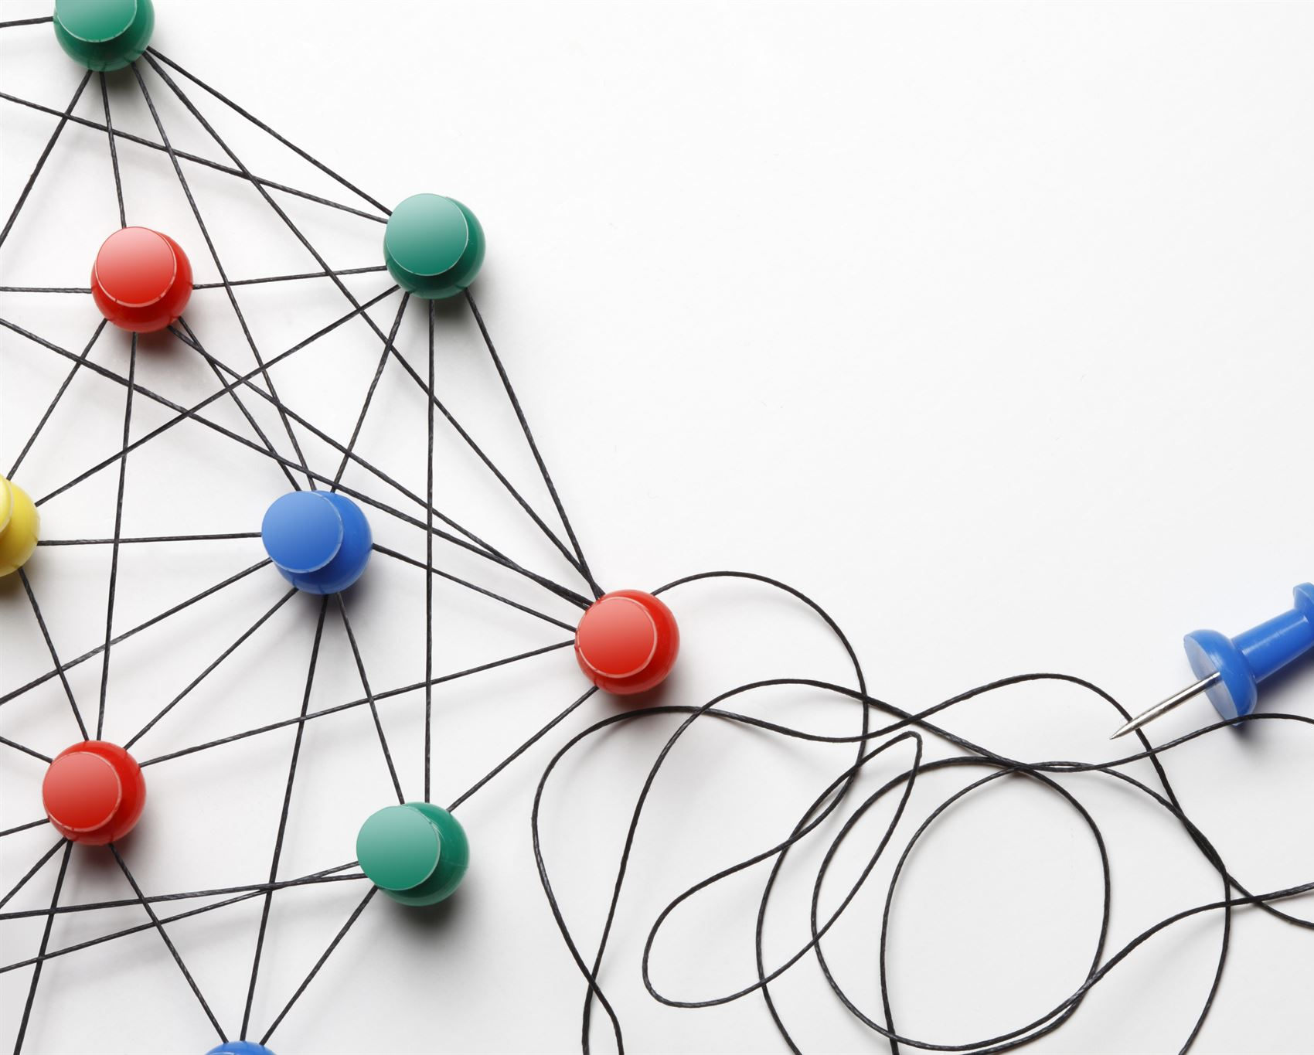
Knowledge Graph why…
Rich Semantics: Capture complex relationships and concepts
Flexibility: Schema-less -> makes it easy (ish) to combine multiple data sources
Enhanced Queries: More powerful and expressive query language for working with densely connected data

Slide 10
Ontology: provides the foundational schema or blueprint that guides how entities (like concepts, objects, or events) and their relationships are represented in the knowledge graph.

Slide 11
Querying the Graph with Cypher - Demo

Slide 12
Ontology + Data = Knowledge Graph
Classes (or Concepts): Categories or types of entities within the domain. For example, in a knowledge graph about healthcare, classes might include "Disease," "Symptom," "Medication," and "Patient.“
Instances (or Individuals): Specific entities that belong to a class. For example, "Diabetes" might be an instance of the class "Disease," and "Aspirin" an instance of the class "Medication.“
Properties (or Attributes): Characteristics or attributes of the classes or instances. For example, the "hasDosage" property might describe the dosage of a medication.
Relations: Defined connections or associations between classes or instances. These might include hierarchical relationships (e.g., "is a" relationships like "Aspirin is a Medication") or more specific associations (e.g., "treats" relationships like "Aspirin treats Headache").
Rules/Constraints: Logical rules or constraints that govern the relationships and properties within the ontology. For example, a rule might state that "Every medication must have a dosage."

Slide 13
LangChain and Neo4j
Neo4jGraph - database connector
GraphDocument -Represents a graph document consisting of nodes and relationships.
LLMGraphTransformer – Transform documents into graph-based documents using an LLM.
Neo4jVector – Neo4j vector store (requires neo4j python package install)

Slide 14
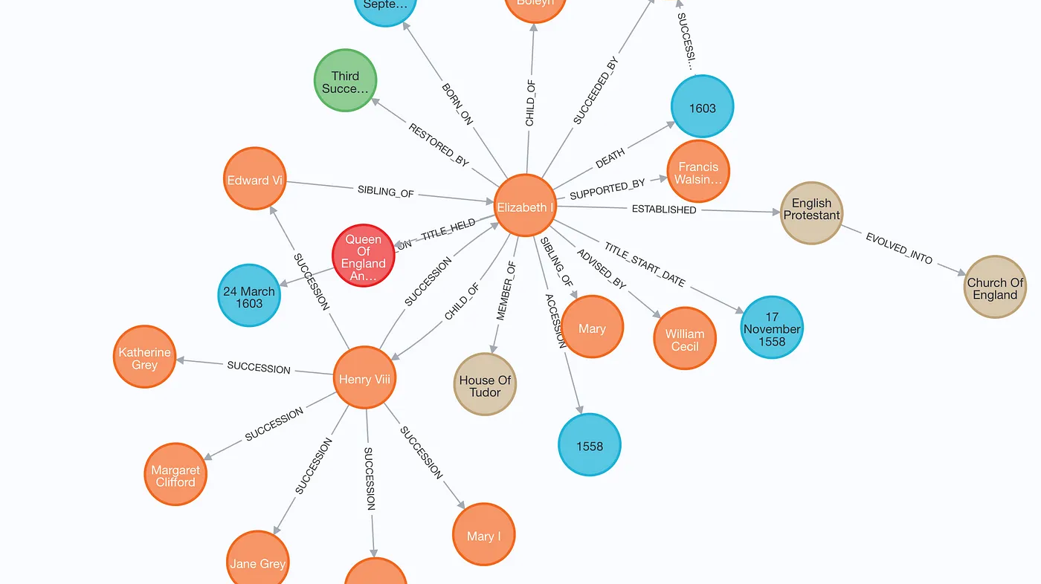
Graph RAG With Neo4j and LangChain - Demo

Slide 15
GraphRAG

Slide 16
Baseline RAG
Knowledge Graph + RAG
MSFT GraphRAG
Uses vector similarity (e.g. ada) for information retrieval on snippets of text (chunks) to add to the context.
Struggles with complex queries that involve connecting multiple pieces of information
Often fails to provide relevant context for complex questions that may span the dataset
Performs a vector similarity search on entities
Uses a knowledge graph to pull in relevant connected data
Injects the collected data into the context
Often fails to provide relevant context for complex questions that may span the dataset
Utilizes LLM-generated knowledge graphs for improved retrieval
Excels at connecting entities and understanding relationships
Splits graph into communities and creates summaries to assist search
Handles whole dataset reasoning, summarizing themes and aggregating information effectively

Slide 17






Comparing Baseline RAG to GraphRAG
Information Extraction
Graph Induction
Dataset Question Generator
Summarized Q&A
etc.
POK leader Sylvia Marek took the stage with Lucio Jakab, founder of Save our Wildlands
GraphRAG
Text Chunks
GraphRAG`
GraphRAG
Too large for context window
“Semantic Search” works, but we know nothing of the dataset!
Graph ML
Topic detection
Representation Learning
Hierarchy extraction
Graph embedding
Entity summarization
Community summarization
GraphRAG
Semantic Search DB
Baseline
Text Chunks
(to ada)
Entity Content
GraphRAG
Larsson, J. (2024, May 5). *GraphRag*. YouTube. https://youtu.be/r09tJfON6kE?si=r5V-w4VlxAzFQcu5
Level 0 Community
Level 1 Communities
Level 2 Communities

Slide 18
Comparing Baseline RAG to GraphRAG
Information Extraction
Dataset Question Generator
Summarized Q&A
etc.
POK leader Sylvia Marek took the stage with Lucio Jakab, founder of Save our Wildlands
Text Chunks
Graph Induction
Data modelling
Data integration
GraphRAG
Too large for context window
“Semantic Search” works, but we know nothing of the dataset!
Semantic Search DB
Baseline
Text Chunks
(to ada)
Top k entities
Entity Content
Larsson, J. (2024, May 5). *GraphRag*. YouTube. https://youtu.be/r09tJfON6kE?si=r5V-w4VlxAzFQcu5
Level 0 Community
Level 1 Communities
Level 2 Communities

Slide 19
GraphRAG - Demo

Slide 20
Questions?

Slide 21
Resources
https://github.com/ms-johnalex/intro-to-graphrag
neo4j-graph-examples (github.com)
Enhancing the Accuracy of RAG Applications With Knowledge Graphs | by Tomaz Bratanic
https://github.com/tomasonjo/blogs/
Project GraphRAG Web Site
GraphRAG: Unlocking LLM discovery on narrative private data - Microsoft Research
microsoft/graphrag: A modular graph-based Retrieval-Augmented Generation (RAG) system (github.com)
Azure-Samples/graphrag-accelerator: One-click deploy of a Knowledge Graph powered RAG (GraphRAG) in Azure (github.com)
GraphRAG python implementation

